Slide 1


Slide 2


Jimm Reed
Director, CoHo Ltd
Development Director, LCH
Notes:
Brief update on LCH- where we are with CID, funding, hub launch, development of the regional enabler

Slide 3
Failure of the conventional housing market
  Developer Led
  RPs/Affordable Housing
Not delivering enough housing to meet our needs
Not delivering the right housing in the right place
Planning system is confrontational and conspires to:
  Increase value of land disproportionately
  Reduces access to land
  Rich man’s game
RPs are like PLCs – attitude to risk & investment
Notes:
Enabler threads

Slide 4
Failure of the conventional housing market
  Majority of our housing & communities are designed & delivered by parties with no interest in their long term sustainability
Notes:
Enabler threads

Slide 5
Challenges for Community Led Housing
  To be part of the mainstream housing conversation?
Be Repeatable
Be Financially Viable
Be Accessible
Be Visible
Be Credible
Notes:
Enabler threads

Slide 6

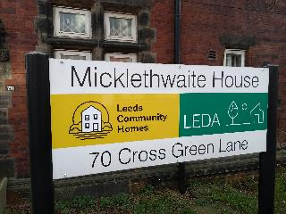
Leeds Community Homes
CID
Share offer
PtC funding
Hub Launch
Regional Enabler
Notes:
Brief update on LCH- where we are with CID, funding, hub launch, development of the regional enabler

Slide 7
Leeds Community Homes
-LCH Regional Enabling Hub
CHF & Funding
Sponsorship of Groups
Sites/ ownership
Developer Led approach
RP/LA led approach
Community organisations-
Notes:
How we see our partnership with LCC:
LCh as the enabling hub for CLH-
Emergence on CHF and conveying funding to groups/ projects
Being professional partner of groups – eg Chaco, SL
CLT- land owning/ custodian of affordability
Interaction with Developers, SPD, custombuild etc. Beckhills example- can we normalise this?
Working with RPs etc and

Slide 8
Enabler Threads
Entrepnr
Group Led
Developer led
LCH led
Local authority/
HA led
Cmty Org Led
legals
finance
land
governance
procurement
design
Notes:
Enabler threads

Slide 9
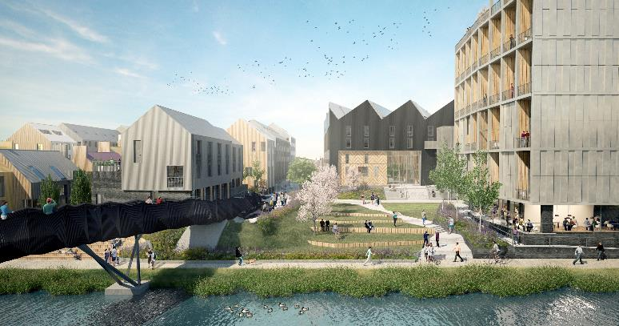
Climate Innovation District

Slide 10
Climate Innovation District
200 Passivhaus homes
Built in Factory on site
Energy CIC
16 Affordable homes through Leeds Community Homes/ Section 106
Funded through Community Share Offer

Slide 11
Mistress Lane, Leeds

Slide 12
Mistress Lane Leeds
Council Site- nil value asset
LCH acting as developer
Mixed Tenure
Community Involvement
Around 30 homes

Slide 13
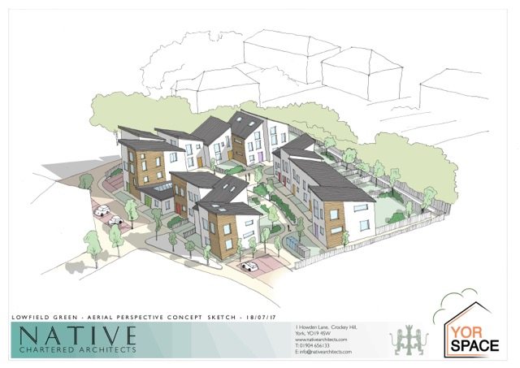
Yorspace

Slide 14
Yorspace
Council Site
Partnership with Council
MHOS
Umbrella CLT/CBS for York
19 Homes

Slide 15
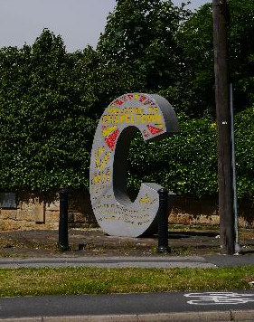
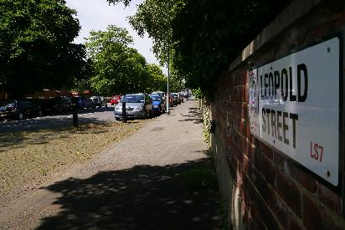
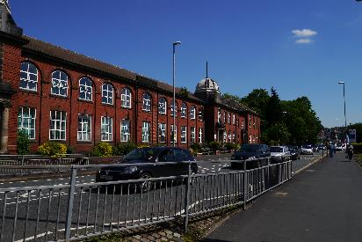


Chaco, Leeds

Slide 16
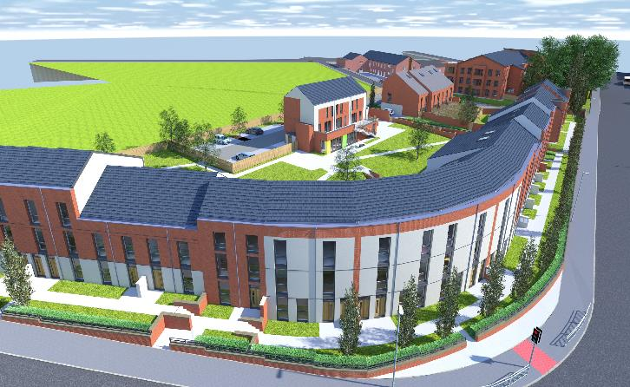
Chaco, Leeds

Slide 17
Chaco, Leeds
Council owned site
Partnership with Unity Housing Association
29 cohousing homes+ CH
4 self build homes
30 affordable rented homes

Slide 18
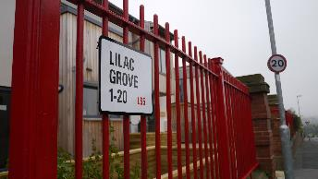
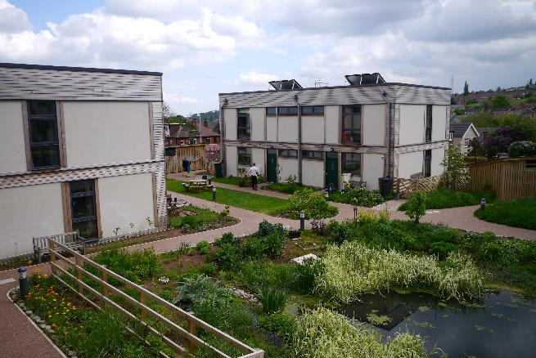
Lilac, Leeds

Slide 19
Lilac, Leeds
Low Impact Living, Affordable Community
20 cohousing homes+ CH
Mutual Home Ownership
Straw modular system (Modcell)

Slide 20
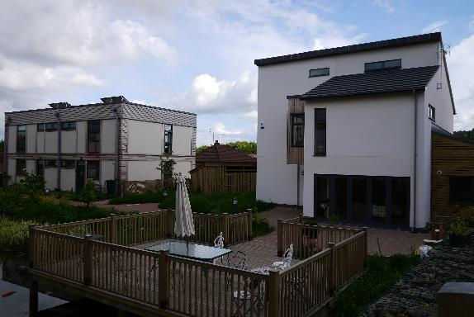
Lilac, Leeds

Slide 21
Community Led Housing
A great opportunity beckons
More relevant than ever before- Grenfell, Localism
Custom/selfbuild- piggyback on legislation
Community Housing Fund

