Slide 1

. Intergenerational fairness and housing for young people . .May 2018

Slide 2
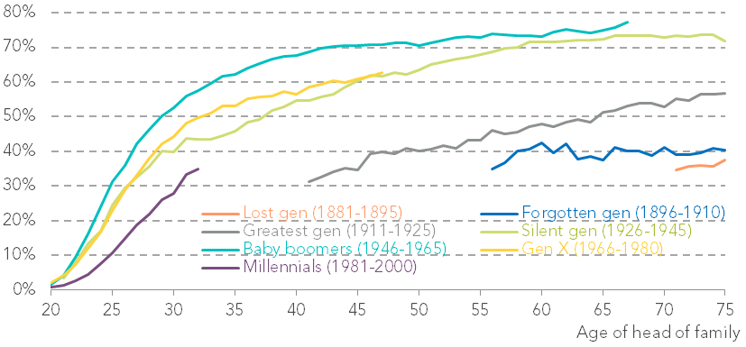
There have been huge generational declines in home ownership…
Home ownership rates, by age and generation: UK: 1961-2017
Notes: See notes to Figure 3 in: A Corlett & L Judge, Home Affront: Housing across the generations, Resolution Foundation, September 2017
Source: RF analysis of ONS, Family Expenditure Survey; ONS, Labour Force Survey
Notes:
Millennials are half as likely to own a home at the age of 30 as baby boomers were.
This is largely due to increased barriers to entry caused by higher house prices, low earnings growth and tighter credit availability post-crisis.
In the 1980s it would have taken a typical household in their late-20s around three years to save for an average-sized deposit - it would now take 19 years.

Slide 3
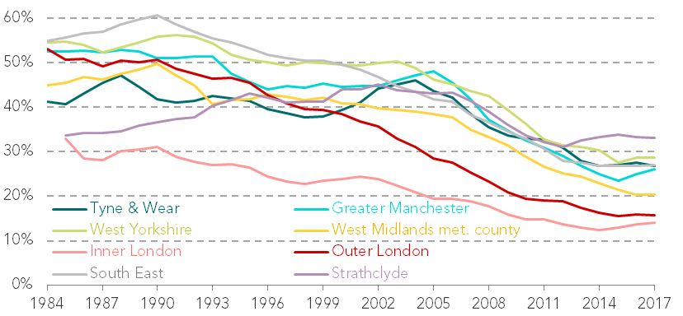
…across the country
Home ownership rates for families headed by 25-34-year-olds, by region (selected regions only)
Source: RF analysis of ONS, Labour Force Survey
Notes:
Millennials are half as likely to own a home at the age of 30 as baby boomers were.
This is largely due to increased barriers to entry caused by higher house prices, low earnings growth and tighter credit availability post-crisis.
In the 1980s it would have taken a typical household in their late-20s around three years to save for an average-sized deposit - it would now take 19 years.

Slide 4
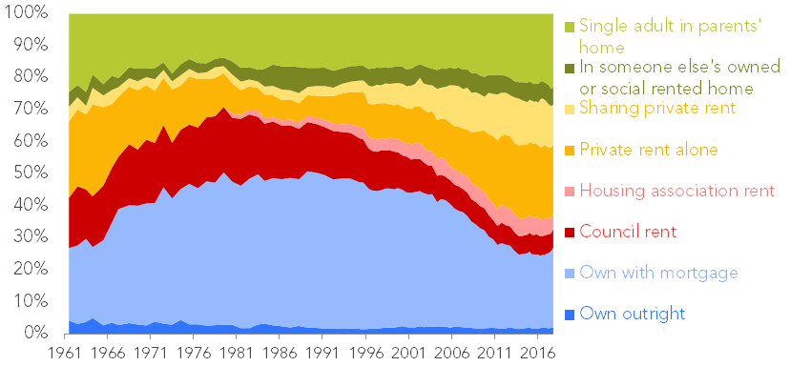
Alongside large declines in social housing, this has caused a huge rise in private renting…
Proportion of families headed by 25-34-year-olds in each tenure: UK
Notes: See notes to Figure 1 in: Home affront (Intergenerational Commission report 9)
Source: RF analysis of ONS, Family Expenditure Survey; ONS, Labour Force Survey

Slide 5
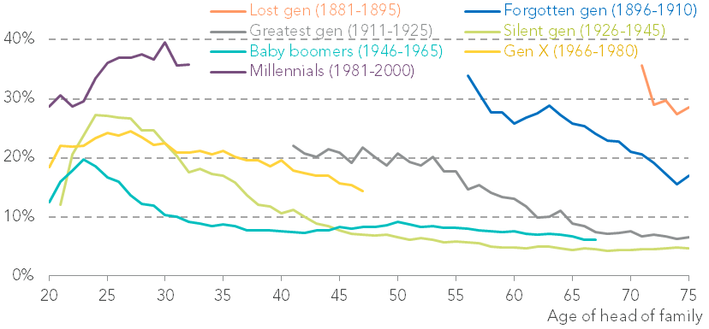
…with millennials four times more likely to be renting privately than Baby boomers were…
Rates of private renting, by age and generation: UK, 1961-2017
Notes: See notes to Figure 10 in: A Corlett & L Judge, Home Affront: Housing across the generations, Resolution Foundation, September 2017
Source: RF analysis of ONS, Family Expenditure Survey; ONS, Labour Force Survey
Notes:
Coupled with huge declines in the availability of social housing, this means that more and more people are renting in the private sector where security is a major issue– with millennials hit the hardest (again)
Millennials are four times more likely to be renting privately than Baby boomers were

Slide 6
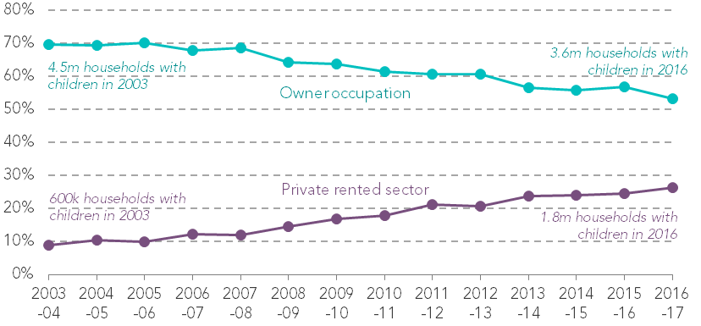
…and spending far more of their lives in the private rented sector
Proportion of households with children in owner occupation and in the private rented sector: England
Source: RF analysis of MHCLG, English Housing Survey
Notes:
But more importantly, they are renting at older ages
This important because private renting is the most insecure tenure – this is ok for young people just starting out, but as we grow, this can become less desirable e.g. if we decide to have children…
There are now record numbers raising children in the PRS
The child-raising years are when security of tenure is needed the most!

Slide 7
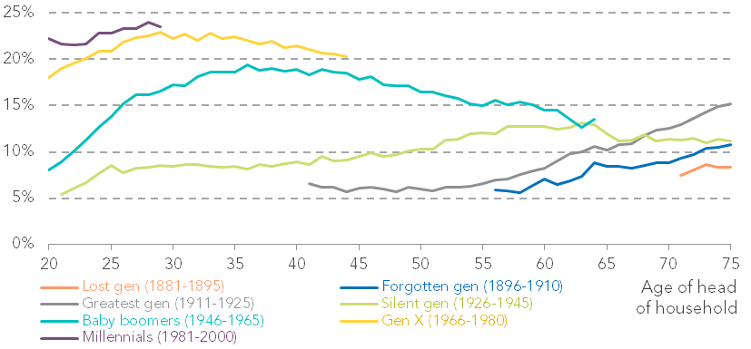
Housing costs have hit new highs…
Proportion of net income spent on housing costs, by generation: GB, 1961-2016
Note: This analysis refers to households, not families as in our analysis of tenure. See notes to Figure 20 in: A Corlett & L Judge, Home Affront: Housing across the generations, Resolution Foundation, September 2017
Source: RF analysis of IFS, Households Below Average Income; DWP, Family Resources Survey
Notes:
Housing costs have been taking up a growing share of incomes for each generation throughout the 20th century.
Millennials are spending an average of almost a quarter of their incomes on housing – with many spending much more
The pre-war silent generation spent on average 8 per cent at a similar age.

Slide 8
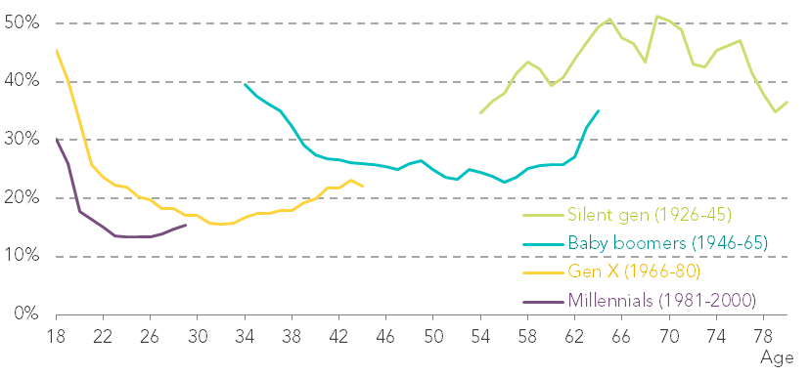
…while state support has been pared back
Proportion of housing costs covered by housing benefit – private renters in receipt of some housing benefit only: UK, 1994-2015
Notes: Data are smoothed using a three-year rolling average over the age range.
Source: RF analyis of DWP, Family Resources Survey
Notes:
Housing costs have been taking up a growing share of incomes for each generation throughout the 20th century.
Millennials are spending an average of almost a quarter of their incomes on housing – with many spending much more
The pre-war silent generation spent on average 8 per cent at a similar age.

Slide 9
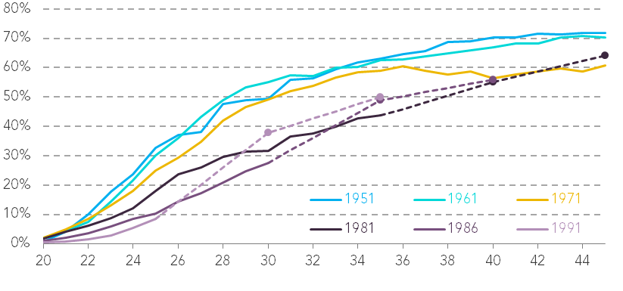
These issues are likely to endure, even in the most optimistic scenario
Actual and projected home ownership rates, by age & birth year: UK: 1961-2027
Notes: Solid lines show out-turn; dashed lines show projections. For details of the modelling approach, see Annex 3 in: A Corlett & L Judge, Home Affront: Housing across the generations, Resolution Foundation, September 2017
Source: RF analysis based on ONS, Family Expenditure Survey; ONS, Labour Force Survey
Notes:
Considering historical market conditions and the interaction of house prices, incomes, credit availability and supply, we model an ‘optimistic’ scenario that assumes the underlying conditions that prevailed in the decade with the strongest home ownership growth (1981-91) are replicated in the coming years.
In this scenario – shown in the left-hand panel of Figure 3.11 – the share of the oldest millennials owning homes would reach similar levels to members of generation X by the age of 45.
But the proportion of owners would remain around 6 percentage points lower among the oldest millennials than it was for the baby boomer generation.
We also model a pessimistic ‘scenario’ in which the poorest-performing home ownership decade (2002-12) are repeated.
less than half of the oldest millennials will own a home by the age of 45, compared to over 70 per cent of baby boomers who had done so by that age

Slide 10
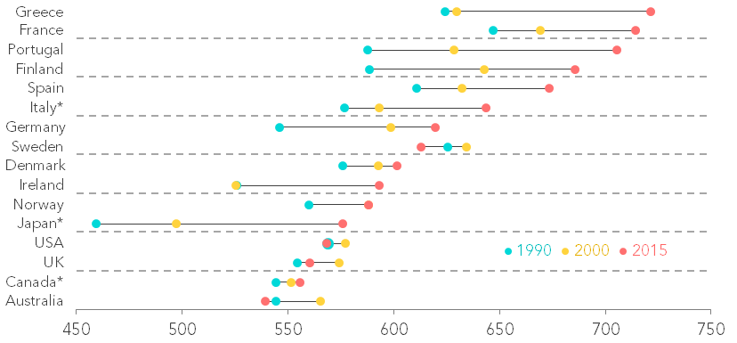
But efforts to solve them have been slightly lacking…
Housing stock per 1,000 inhabitants aged 20+
Notes: Countries with asterisks are those for which 2015 data has been imputed based on 2010 results.
Source: RF analysis of OECD, Questionnaire on Affordable and Social Housing; EMF, Hypostat; UN, Population Prospects
Notes:
Housing costs have been taking up a growing share of incomes for each generation throughout the 20th century.
Millennials are spending an average of almost a quarter of their incomes on housing – with many spending much more
The pre-war silent generation spent on average 8 per cent at a similar age.

Slide 11
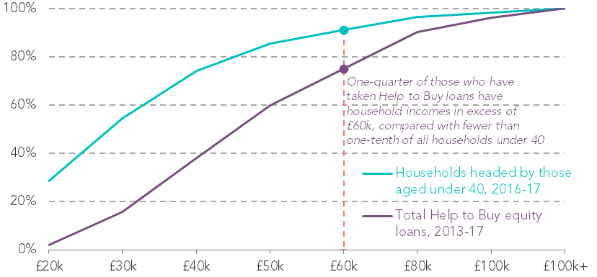
…or poorly targeted
Proportion of households headed by under 40s and Help to Buy equity loan recipient households, by net household income: England, 2013-17
Notes: Incomes are measured before housing costs, and are equivalised to account for differences in household size.
Source: RF analysis of DWP, Households Below Average Income; MHCLG, Help to Buy (Equity Loan scheme); MHCLG, Help to Buy: NewBuy
Notes:
Housing costs have been taking up a growing share of incomes for each generation throughout the 20th century.
Millennials are spending an average of almost a quarter of their incomes on housing – with many spending much more
The pre-war silent generation spent on average 8 per cent at a similar age.

Slide 12
So what do we propose?
Reducing insecurity
Indeterminate tenancies; and limit rent increases to inflation for three-year periods
Rebalancing demand
Replace council tax with a progressive property tax with surcharges on second and empty properties
Halve stamp duty and introduce a time-limited capital gains tax cut for sales to first-time buyers
Increasing supply
Community land auctions; and a £1.7 billion building precept
Notes:
Make indeterminate tenancies the sole form of private rental contract, with light-touch rent stabilisation limiting rent increases to inflation for three-year periods and disputes settled by a new housing tribunal.#
Replace council tax with a progressive property tax with surcharges on second and empty properties; halve stamp duty rates to encourage moving; and offer a time-limited capital gains tax cut to incentivise owners of additional properties to sell to first-time buyers.
Pilot community land auctions so local authorities can bring more land forward for house building, underpinned by stronger compulsory purchase powers; and introduce a £1.7 billion building precept allowing local authorities to raise funds for house building in their area.

Slide 13
. Intergenerational fairness and housing for young people . .May 2018

